Slide 1

IT Services

Slide 2
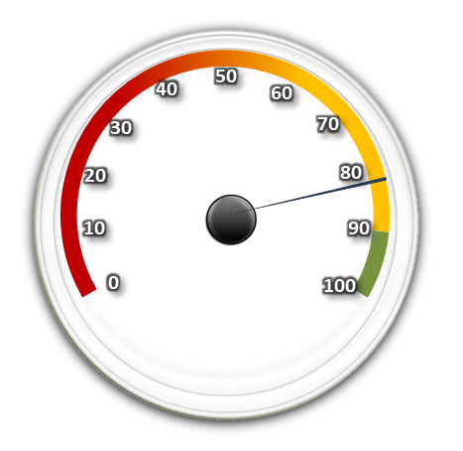
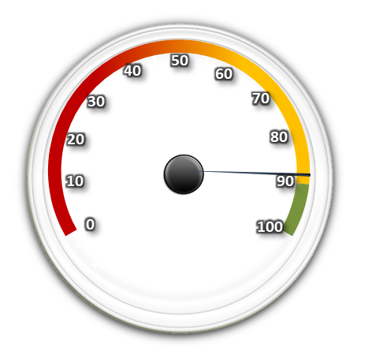
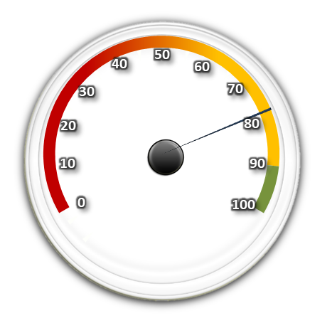
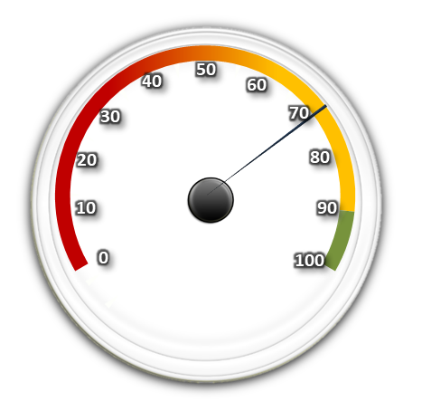
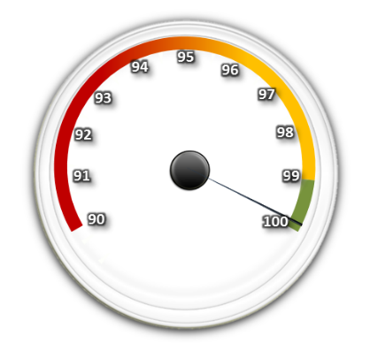
Executive Summary – Jun 2018
KPI
KPIs (whilst breaching) are trending upwards due to the focus on ticket management,
G21 Nodal Room work complete - Network resilience now in place,
Significant progress on Two Factor Authentication implementation.
No failed changes within June,
DDI project - Increased risk during the DNS migrations,
Customer Satisfaction
Definitions
CYTD: Calendar Year to Date
DC: Datacentre 1 and/or 2
DTL: Domain Team Lead
KPI: Key Performance Indicator
MI: Major Incident
P1: Priority 1 Incident (High)
SLT: Service Level Target
(939)
(3791)
Incidents
82%
Requests
88%
(898)
0
98%
Major Incident
(11)
(60)
There were no Major Incidents within June.
P1 Inc.
78%
P2 Inc.
72%
Volumes
Tickets volumes have decreased within June (as expected) during the examination period and staff using up annual leave.
We are working on enabling the Service Desk to resolve more tickets first time.
Customer Satisfaction has hit 98% (well above the 95% target) with a response rate of 20% of total tickets.
Critical Systems Availability
CYTD
Jun
Critical systems availability continues to increase due to the focus on resolving high priority incidents and the recent closure of numerous Risks.
0.1%
0.3%
99.4%
99.8%
www.qmul.ac.uk
/QMUL
@QMUL
Queen Mary University of London

Slide 3
Customer Satisfaction – Jun 2018
Customer Feedback
This month we received 898 responses providing feedback to incidents and requests logged through the Service Desk - equating to an overall response rate of 20% (which is the usual average of 20% received).
You can email your feedback by selecting one of the following links on your resolution email;
Delighted Happy Un-Happy Disgruntled
We value all feedback as ultimately it helps us to continually improve the service(s) we provide.
98%
(702)
97%
(196)
98%
(898)
Feedback this month
Commentary
Customer Satisfaction is continuing to trend upwards (well above the 95% target)
The Customer Services Management document which we have mentioned over the previous months is in the process of being rolled out to the IT Department to enable a consistent Service to be delivered to all customers
Thank you for sorting this out – but it took 5 days since first reported to have this resolved.
What a fantastic service: knowledgeable, dispassionate, empathetic and quick.
Thank you for your help and patience once again.
Perfect Service, thank you
The shared drive has not been set up. This is the second time a new user has been set up and shared drive has not been allocated.
Disgruntled not with you, just the instability of my current MacBook!
www.qmul.ac.uk
/QMUL
@QMUL
Queen Mary University of London
Notes:
Feedback:. Disgruntled not with you, just the instability of my current MacBook! (260514)
User: Matteo Mandarini
Issue: Matteo had various performance issues with his MacBook and the timelines involved with obtaining a new device.
Update: The new device is ready for collection.
Feedback:. The shared drive has not been set up. This is the second time a new user has been set up and shared drive has not been allocated. (259540)
User: Bahar Shahin
Issue:. Shared drive access not provided
Update: Tickets weren’t appropriately actioned and have now been resolved.
Feedback: Thank you for sorting this out – but it took 5 days since first reported to have this resolved. (173518)
User: Rukhsana Yasmin
Issue:. Desktop making loud noises
Update: Delays within CCS – not sure of the reason

Slide 4












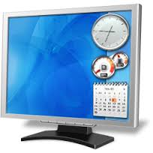



Activities for the month of Jun 2018
Research Excellence
Teaching Excellence
International
Logins to QMPLUS
195,659
Reported AV Issues
48
Research Grant Bids
121
Distance learning
(Beijing and Nanchang QMPLUS logins):
367,647
AV Teaching activities Supported
280
Supported teaching spaces
Approx.177
Research Grants Awarded
59
2,332
Videos played
8,743
times within QMplus
Hours of Q-review
1,825
Playbacks
Public Engagement
QMUL
IT Services
Sustainability
Guest Wi-Fi:
393 users
8,133 sessions
25,321
Pages sent and not printed
Growth
20
New
desktops/laptops
Deployed
Approx. 95,700
Registered mail accounts
Events Wi-Fi:
2,743 users
150,779 sessions
Total data stored
667 terabytes
1
www.qmul.ac.uk
/QMUL
@QMUL
Queen Mary University of London
Notes:
Higher usage in Events Wifi this month
Storage did not include the VMs last month, which is the reason for the high storage this month.

Slide 5
ITS Critical Systems Availability – Jun 2018
MyHR
Tues 26 Jun – 1h
(Ticket No. 174310)
QMplus Hub
wed 20 Jun – 40m
(Ticket No. 174164)
Staff Konica Printing
Tues 26 Jun – 4h
(Ticket No. 174309)
Telephone Services in GO Jones
Tues 12 Jun – 3h 22m
(Ticket No. 173891)
Email
Fri 29 Jun – 7h 20m
(Ticket No. 174468)
EXT 8888
Wed 27 Jun – 1h
(Ticket No. 174386)
Network Services in GO Jones
Tues 12 Jun – 3h 22m
(Ticket No. 173891)
Network Services in ITL
Mon 18 Jun – 25m
(Ticket No. 174095)
Jun: 99.8%
CYTD: 99.4%
www.qmul.ac.uk
/QMUL
@QMUL
Queen Mary University of London

Slide 6
High Priority Incidents – Jun 2018
HPI Number | Date | Duration | Service Affected – Impact | Status
173891 | Tues 12 Jun 08:00 | 3h 22m | Network & Telephone Services – Users in the GO Jones building were unable to access both telephone and network services. Cause: A loss of power to the building Action: Checks to ensure all Network Services were back up after power restoration | Resolved
174095 | Mon 18 Jun 15:40 | 25m | Network Services – Users in the IT Lab (ITL) building were unable to access Network services. Cause: Loss of power in the ITL building Action: Checks to ensure all Network Services were back up after power restoration | Resolved
174164 | Wed 20 Jun 13:20 | 40m | QMplus Hub – Users were unable to access the QMplus hub portal Cause: ULCC Server disc was full, because the Mahara application failed to clear the cache Action: Escalated to ULCC who manually cleared the cache | Resolved
174309 | Tues 26 Jun 08:00 | 4h | Konica Staff Printing – Users unable to print on the Staff Managed Print service Cause: High volume of print jobs were pooled causing the server crash Action: Restarted the print server & print spooler and deleted the cashed print jobs | Resolved
174310 | Tues 26 Jun 09:00 | 1h | MyHR – Users unable to access MyHR Cause: Issue with Database Server Action: Removed the impacted database out of the high availability cluster | Resolved
174386 | Wed 27 Jun 08:10 | 1h | 8888 Ext – Users had to listen to the welcome message 3 times before getting though to the Service Desk Cause: Call flow had the same message set to playback three times Action: Removed two instances of the recording and tested | Resolved
174468 | Fri 29 Jun 08:40 | 7h 20m | Email – Some users experienced repeated credential prompts when attempting to access their mailbox using Thunderbirds and Mac mail Cause: A unknown Microsoft issue (however Webmail was available for affected users) Action: Escalated to Microsoft | Resolved
www.qmul.ac.uk
/QMUL
@QMUL
Queen Mary University of London
Notes:
173589 – Marked as P1 when only one Printer was affected
173673 – Sentry stopped working, turnstile gates in library were in an offline mode
173806 – Not clear what the incident is , ticket seems more like a request for backing up the Database of the Rhythmx application
173848 – BI Live portal down- issues self resolved
173925 – Ticket Cancelled
174048 – remove the student name from the timetable template – More like a Request than an incident
174254 – script error

Slide 7
Planned Maintenance – Jun 2018
Change Ticket | Date | Duration | Service Affected – Impact | Reason | Status
12052 12200 | 4 Jun 5 Jun | 30m | Internet – No expected impact to services during the maintenance period. | Upgrade | Implemented
12224 | 5 Jun | 2h | Email – Users were unable to send or receive email outside the QMUL network during the maintenance (some system generated emails were also affected) | Maintenance | Implemented
12192 | 6 Jun | 1h | Rhythmx – Users were unable to access the content management system | Maintenance | Implemented
12205 | 8 Jun | 2h | Internet – There was no expected impact to services during the migration | Migration | Implemented
12203 | 8 Jun | 2h | MySIS – Users were unable to access the service during the maintenance period | Maintenance | Implemented
12216 | 10 Jun | 1h | Student File System – Students’ (storage) home drives were unavailable service during the maintenance period | Migration | Implemented
12264 | 15 Jun | 10m | Internet – No expected impact to services during the maintenance period | Upgrade | Implemented
12273 | 26 Jun | 45m | Network Services – Three expected interruptions to network access (each lasting 6-8 min) during the maintenance period | Maintenance | Implemented
12329 | 26 Jun | 30m | MyHR & Resourcelink – Users were unable to access the service during the maintenance period | Migration | Implemented
- | 28 Jun | 24h | Research Apocrita HPC – Users were unable to access the service during the maintenance period | Maintenance | Implemented
www.qmul.ac.uk
/QMUL
@QMUL
Queen Mary University of London
Notes:
N/A

Slide 8
ITS Incident and Request KPIs – Jun 2018
Measure | Target | Apr 18 | May 18 | Jun 18 | Trend | Expected Trend
Incidents Raised | - | 1300 | 1428 | 939
Number of Incidents Resolved | - | 1145 | 1389 | 930
Incidents Resolved within SLT | 90% | 85% | 88% | 82%
Resolution Time P1 | 4h | 33% | 50% | 78%
Resolution Time P2 | 1 BD | 78% | 68% | 72%
Resolution Time P3 | 3 BD | 85% | 89% | 82%
Resolution Time P4 | 5 BD | 74% | 99% | 94%
Resolution Time P5 | 20 BD | 100% | 89% | 92%
Requests Raised | - | 3601 | 4027 | 3791
Number of Requests Resolved | - | 3577 | 3886 | 3527
Requests Resolved within SLT | 90% | 86% | 91% | 88%
Reopened tickets | - | - | 205 (4%) | 207 (5%)
Commentary
Tickets volumes have decreased within June (as expected) during the examination period and staff using up annual leave.
KPIs (whilst breaching) are trending upwards due to the focus on ticket management.
Key
Improvement over last month and within SLT
Deterioration from last month but within SLT
No change from last month and within SLT
Improvement over last month and breaching SLT
Deterioration from last month but breaching SLT
No change from last month and breaching SLT
Improvement over last month, No SLT assigned
Deterioration from last month, No SLT assigned
No change from last month, No SLT assigned
BD = Business Day (Mon – Fri, 8am to 6pm excluding weekends, bank holidays and College closure periods)
NOTE: All volumes on this slide include ITS resolved tickets only (not including E-Learning and Library)
www.qmul.ac.uk
/QMUL
@QMUL
Queen Mary University of London

Slide 9
Incident and Requests KPIs – Jun 2018
Clearing
Enrolment period
Enrolment period
Clearing
Enrolment period
Enrolment period
www.qmul.ac.uk
/QMUL
@QMUL
Queen Mary University of London

Slide 10




Service Desk Performance – Jun 2018
Commentary
Tickets volumes have decreased within June (as expected) during the examination period and staff using up annual leave.
We are working on enabling the Service Desk to resolve more tickets first time.
Abandonment rates and wait times for calls to the Service Desk are now under control due to the additional contractors brought in.
Measure | Target | Apr 18 | May 18 | Jun 18 | Trend | Expected Trend
Received phone calls | - | 2379 | 2326 | 1949
Average Wait Time | 25s | 22s | 16s | 15s
Abandon Rate (calls) | 5% | 16% | 6% | 6%
FTF (First Time Fix) | 75% | 64% | 65% | 56%
FLF (First Line Fix) | 75% | 57% | 58% | 51%
Key
Improvement over last month and within SLT
Deterioration from last month but within SLT
No change from last month and within SLT
Improvement over last month but breaching SLT
Deterioration from last month and breaching SLT
No change from last month and breaching SLT
Improvement over last month, No SLT assigned
Deterioration from last month, No SLT assigned
No change from last month, No SLT assigned
FTF = All tickets logged and resolved immediately by either the Service Desk or Campus Customer Support (CCS) team
FLF = All tickets resolved by the service desk within SLA without being escalated any further
ITS Ticket Volume | Apr 18 | May 18 | Jun 18 | Trend | Expected Trend
 | 813 | 1059 | 717
 | 2516 | 2517 | 2495
 | 617 | 738 | 443
 | 925 | 1113 | 1030
www.qmul.ac.uk
/QMUL
@QMUL
Queen Mary University of London

Slide 11
Risk Report – Jun 2018
Top 5 Risks:
Security & Resilience of legacy servers and applications not in the Datacentre - Exposure is low as most if not all applications have been migrated (awaiting confirmation).
No Overarching Disaster Recovery plan or scheduled DR tests - Some recovery procedures in place, DR testing is being scoped and scaled.
Security Vulnerability – Multi Factor Authentication not in use to access all critical services.
Phishing – Risk stable this month, heighten awareness as phishing email are still being received.
Network resilience for legacy firewall and routers – No resilience in some core network nodal rooms that host legacy routers and firewalls is much lower this month due to the completion of G21.
New Risk : There are a number of DNS migrations planned as part for the DDI project, which are quite complex and it is not always clear whether any dependencies exist. Any failure or unsuccessful migration could lead to service disruption across QMUL.
Monthly Risk Stats
Risks Averted | Re- Assigned | New Risks | Total Risks | Risks Realised | Monthly Trend
5 | 0 | 0 | 50 | 0
Key
Deteriation over last month
Improvement from last month
No change from last month
www.qmul.ac.uk
/QMUL
@QMUL
Queen Mary University of London

Slide 12
KPI Trend View – Jun 2018
KPI | June | Jul | Aug | Sep | Oct | Nov | Dec | Jan | Feb | Mar | Apr | May | Jun | Move
% Satisfied Customers for Incidents | 97 | 91 | 95 | 94 | 96 | 98 | 97 | 97 | 97 | 96 | 92 | 95 | 97
% Satisfied Customers for Requests | 97 | 95 | 98 | 97 | 95 | 97 | 98 | 95 | 97 | 98 | 98 | 98 | 98
All Incidents Closed By All ITS Depts. Within SLT | 83 | 90 | 89 | 85 | 80 | 86 | 85 | 87 | 86 | 84 | 85 | 88 | 82
All Requests Closed By All ITS Depts. Within SLT | 90 | 94 | 95 | 95 | 89 | 92 | 92 | 90 | 91 | 87 | 86 | 91 | 88
All Incidents Closed By Site Within SLT | 81 | 89 | 77 | 78 | 78 | 87 | 85 | 86 | 84 | 83 | 86 | 84 | 81
All Requests Closed By Site Within SLT | 88 | 93 | 89 | 87 | 88 | 92 | 91 | 89 | 92 | 87 | 88 | 92 | 89
Service Desk Incidents Closed Within SLT | 94 | 96 | 92 | 86 | 87 | 95 | 93 | 96 | 93 | 90 | 90 | 96 | 96
Service Desk Requests Closed Within SLT | 94 | 96 | 91 | 91 | 91 | 97 | 96 | 93 | 92 | 90 | 90 | 95 | 97
Service Desk Telephone Response Within SLT | 94 | 93 | 97 | 90 | 93 | 96 | 95 | 93 | 86 | 84 | 83 | 93 | 93
All Incidents Closed By Campus Teams Within SLT | 73 | 85 | 74 | 75 | 73 | 85 | 86 | 87 | 88 | 81 | 88 | 86 | 79
All Requests Closed By Campus Teams Within SLT | 79 | 90 | 85 | 82 | 86 | 88 | 90 | 88 | 94 | 90 | 93 | 93 | 89
Change Management Implementation
Key
Improvement over last month
Deterioration from last month
No change from last month
www.qmul.ac.uk
/QMUL
@QMUL
Queen Mary University of London

Slide 13
Questions about this report, or would you like to know more?
Contact: Amit Patel
Head of Service Management – IT Services
Email Amit.Patel@qmul.ac.uk
Tel: 020 7882 8976
www.qmul.ac.uk
/QMUL
@QMUL
Queen Mary University of London

